Slide 1
A Survey of Mining Frequent Itemsets over Uncertain Databases
Yongxin Tong
Department of Computer Science and Engneering
The Hong Kong University of Science and Technology

Slide 2
Outline
Motivations
  Examples of Mining Uncertain Frequent Itemsets (FIs)
  Deterministic FI Vs. Uncertain FI
  Evaluation Goals
Problem Definitions
Evaluations of Algorithms
  Expected Support-based Frequent Algorithms
  Exact Probabilistic Frequent Algorithms
  Approximate Probabilistic Frequent Algorithms
Conclusions
Notes:
This is the outline of our presentation.
First I will introduce an a motivating example and some basic concepts of frequent itemsets over uncertain databases.
Then I will briefly introduce the design and performance of the MPFCI algorithm for such problem.

Slide 3
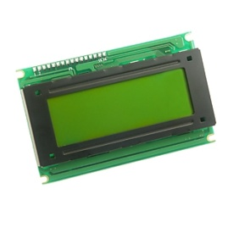

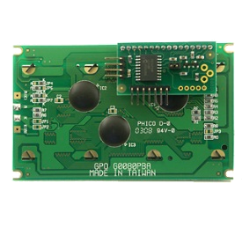
Motivation Example
In an intelligent traffic system, many sensors are deployed to collect real-time monitoring data in order to analyze the traffic jams.
TID | Location | Weather | Time | Speed | Probability
T1 | HKUST | Foggy | 8:30-9:00 AM | 90-100 | 0.3
T2 | HKUST | Rainy | 5:30-6:00 PM | 20-30 | 0.9
T3 | HKUST | Sunny | 3:30-4:00 PM | 40-50 | 0.5
T4 | HKUST | Rainy | 5:30-6:00 PM | 30-40 | 0.8
Notes:
Recently, uncertain data is prevalent in many real application, such as
In recent years, applications like sensor network, object identification are utilized to provide real-time monitoring of all kinds of environments. The sensory data provides tremendous information, but they also incur great uncertainty.
For example, in an intelligent traffic system, many sensors are deployed to collect real-time traffic data. (show animation) Each time a vehicle passes the monitor, a set of sensory data are collected like weather, time, speed of driving, etc.
However, due to the limitation of sensors, like the measuring ability, battery condition and transmission error, etc., the collected data are not always precise. On the contrary, in most cases, the sensory data are associated with a probability, which indicates how likely such a tuple is correct.

Slide 4
Motivation Example (cont’d)
TID | Location | Weather | Time | Speed | Probability
T1 | HKUST | Foggy | 8:30-9:00 AM | 90-100 | 0.3
T2 | HKUST | Rainy | 5:30-6:00 PM | 20-30 | 0.9
T3 | HKUST | Sunny | 3:30-4:00 PM | 40-50 | 0.5
T4 | HKUST | Rainy | 5:30-6:00 PM | 30-40 | 0.8
According to above data, we analyze the reasons that cause the traffic jams through the viewpoint of uncertain frequent pattern mining.
For example, we find that {Time = 5:30-6:00 PM; Weather = Rainy} is a frequent itemset with a high probability.
Therefore, under the condition of {Time = 5:30-6:00 PM; Weather = Rainy}, it is very likely to cause the traffic jams.
Notes:
[Now that we have collected all the data from real-time system, the next topic is how to discover informative knowledge from such data for further decision making. As to the analysis of real-time traffic, people are interested to discover the patterns that appear most frequently.]
Let’s have a look at the specific data. Without too much effort, we may note that during the period of 5:30 to 6:00, when the weather is rainy, the traffic is abnormally slow. This combination of attributes appear twice and with high probability.
The appearance of abnormally slow traffic speed indicates there is a jam happening. So the intelligent system will report an important knowledge that, under condition of 5:30~6:00, especially when the weather are rainy, there is a high possibility that traffic jam will appear. In this case, proper forecast and suggestion can be released to users promptly.
Thus, this is a typical real application of uncertain frequent itemset mining.

Slide 5
Outline
Motivations
  Examples of Mining Uncertain Frequent Itemsets (FIs)
  Deterministic FI Vs. Uncertain FI
  Evaluation Goals
Problem Definitions
Algorithm Evaluations
  Expected Support-based Frequent Algorithms
  Exact Probabilistic Frequent Algorithms
  Approximate Probabilistic Frequent Algorithms
Conclusions
Notes:
This is the outline of our presentation.
First I will introduce an a motivating example and the concept of probabilistic frequent itemsets.
Then I will briefly introduce the design and performance of the MPFCI algorithm for such problem.

Slide 6
Deterministic Frequent Itemset Mining
Itemset: a set of items, such as {abc} in the right table.
Transaction: a tuple <tid, T> where tid is the identifier, and T is a itemset, such as the first line in the right table is a transaction.
TID | Transaction
T1 | a b c d e
T2 | a b c d
T3 | a b c f
T4 | a b c e
A Transaction Database
Support: Given an itemset X, the support of X is the number of transactions containing X. i.e. support({abc})=4.
Frequent Itemset: Given a transaction database TDB, an itemset X, a minimum support σ, X is a frequent itemset iff. sup(X) > σ
For example: Given σ=2, {abcd} is a frequent itemset.
The support of an itemset is only an simple count in the deterministic frequent itemset mining!
Notes:
Differentiate
The two groups are distinguished according to their closed frequent itemsets ”abc” and “abcd”(…). The closed itemsets is the itemsets with largest size of items, which covers all smaller ones.
In certain transaction data, there are two conditions for a frequent closed itemsets: first, it has to be frequent; second, its support must be greater than all of its supersets.
Again let’s check the itemsets “abc” in running example. For the first condition, it has support of 4, which satisfies the minimum support condition of 2. For the second condition, all of its supersets have support less and equal to 4. Thus “abc” is frequent closed itemset. Also we may find that “abcd” is also frequent closed. But the itemset “abcde” is not frequent closed because its support is 1.
So in the following, we will study how to extend the method of mining frequent closed itemsets in certain data to the uncertain data.

Slide 7
Deterministic FIM Vs. Uncertain FIM
Transaction: a tuple <tid, UT> where tid is the identifier, and UT={u₁(p₁), ……, u_{m}(p_{m})} which contains m units. Each unit has an item u_{i} and an appearing probability p_{i}.
TID | Transaction
T1 | a(0.8) b(0.2) c(0.9) d(0.5) e(0.9)
T2 | a(0.8) b(0.7) c(0.9) d(0.5) f(0.7)
T3 | a(0.5) c(0.9) f(0.1) g(0.4)
T4 | b(0.5) f(0.1)
An Uncertain Transaction Database
Support: Given an uncertain database UDB, an itemset X, the support of X, denoted sup(X), is a random variable.
How to define the concept of frequent itemset in uncertain databases?
There are currently two kinds of definitions:
  Expected Support-based frequent itemset.
  Probabilistic frequent itemset.
Notes:
But, different from the deterministic version, in uncertain databases, each item ui has an appearing probability pi, which measns the probability that the item appears.

Slide 8
Outline
Motivations
  Examples of Mining Uncertain Frequent Itemsets (FIs)
  Deterministic FI Vs. Uncertain FI
  Evaluation Goals
Problem Definitions
Algorithm Evaluations
  Expected Support-based Frequent Algorithms
  Exact Probabilistic Frequent Algorithms
  Approximate Probabilistic Frequent Algorithms
Conclusions
Notes:
This is the outline of our presentation.
First I will introduce an a motivating example and the concept of probabilistic frequent itemsets.
Then I will briefly introduce the design and performance of the MPFCI algorithm for such problem.

Slide 9
Evaluation Goals
  Explain the relationship of exiting two definitions of frequent itemsets over uncertain databases.
  The support of an itemset follows the Poisson Binomial distribution.
  When the size of data is large, the expected support can approximate the frequent probability with the high confidence.
  Clarify the contradictory conclusions in existing researches.
  Can the framework of FP-growth still work in uncertain environments?
  Provide an uniform baseline implementation and an objective experimental evaluation of algorithm performance.
  Analyze the effect of the Chernoff Bound in the uncertain frequent itemset mining issue.
Notes:
Let’s see the two important definitions in this paper. The first one is…
Based on the first definition, we can define the probabilistic frequent closed itemset.

Slide 10
Outline
Motivations
  Examples of Mining Uncertain Frequent Itemsets (FIs)
  Deterministic FI Vs. Uncertain FI
  Evaluation Goals
Problem Definitions
Algorithm Evaluations
  Expected Support-based Frequent Algorithms
  Exact Probabilistic Frequent Algorithms
  Approximate Probabilistic Frequent Algorithms
Conclusion
Notes:
This is the outline of our presentation.
First I will introduce an a motivating example and the concept of probabilistic frequent itemsets.
Then I will briefly introduce the design and performance of the MPFCI algorithm for such problem.

Slide 11
Uncertain Data Models
Attribute-based Model
Tuple-based Model
TID | Transaction
T1 | a(0.8) b(0.2) c(0.9) d(0.5) e(0.9)
T2 | a(0.8) b(0.7) c(0.9) d(0.5) f(0.7)
T3 | a(0.5) c(0.8) f(0.1) g(0.4)
T4 | b(0.5) f(0.1)
… | ……
TID | Transaction | Prob.
T1 | a b c d e | 0.9
T2 | a b c d f | 0.8
T3 | a c f g | 0.5
T4 | b f | 0.1
… | …… | …
In this survey, we only focus on mining frequent itemsets over static uncertain databases, do not include dynamic uncertain environments, such as uncertain streams.
Notes:
Let’s see the two important definitions in this paper. The first one is…
Based on the first definition, we can define the probabilistic frequent closed itemset.

Slide 12
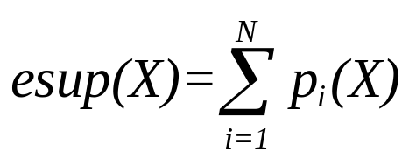

Expected Support-based Frequent Itemset
Expected Support
  Given an uncertain transaction database UDB including N transactions, and an itemset X, the expected support of X is:
Expected-Support-based Frequent Itemset
  Given an uncertain transaction database UDB including N transactions, a minimum expected support ratio min_esup, an itemset X is an expected support-based frequent itemset if and only if
Notes:
Let’s see the two important definitions in this paper. The first one is…
Based on the first definition, we can define the probabilistic frequent closed itemset.

Slide 13

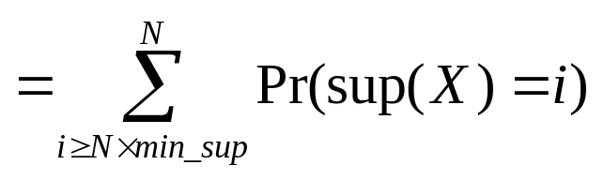
Probabilistic Frequent Itemset
Frequent Probability
  Given an uncertain transaction database UDB including N transactions, a minimum support ratio min_sup, and an itemset X, X’s frequent probability, denoted as Pr(X), is:
Probabilistic Frequent Itemset
  Given an uncertain transaction database UDB including N transactions, a minimum support ratio min_sup, and a probabilistic frequent threshold pft, an itemset X is a probabilistic frequent itemset if and only if
Notes:
Let’s see the two important definitions in this paper. The first one is…
Based on the first definition, we can define the probabilistic frequent closed itemset.

Slide 14
Examples of Problem Definitions
TID | Transaction
T1 | a(0.8) b(0.2) c(0.9) d(0.5) e(0.9)
T2 | a(0.8) b(0.7) c(0.9) d(0.5) f(0.7)
T3 | a(0.5) c(0.8) f(0.1) g(0.4)
T4 | b(0.5) f(0.1)
sup(a) | 0 | 1 | 2 | 3
Probability | 0.1 | 0.18 | 0.4 | 0.32
An Uncertain Transaction Database
The Probability Distribution of sup(a)
Expected-Support-based Frequent Itemset
  Given the uncertain transaction database above, min_esup=0.5, there are two expected-support-based frequent itemsets: {a} and {c} since esup(a)=2.1 and esup(c)=0.9+0.9+0.8=2.6 > 2 = 4×0.5.
Probabilistic Frequent Itemset
  Given the uncertain transaction database above, min_sup=0.5, and pft=0.7, the frequent probability of {a} is: Pr(a)=Pr{sup(a) ≥4×0.5}= Pr{sup(a) =2}+Pr{sup(a) =3}=0.4+0.32>0.7.
Notes:
Let’s see the two important definitions in this paper. The first one is…
Based on the first definition, we can define the probabilistic frequent closed itemset.

Slide 15
Outline
Motivations
  Examples of Mining Uncertain Frequent Itemsets (FIs)
  Deterministic FI Vs. Uncertain FI
  Evaluation Goals
Problem Definitions
Algorithm Evaluations
  Expected Support-based Frequent Algorithms
  Exact Probabilistic Frequent Algorithms
  Approximate Probabilistic Frequent Algorithms
Conclusions
Notes:
This is the outline of our presentation.
First I will introduce an a motivating example and the concept of probabilistic frequent itemsets.
Then I will briefly introduce the design and performance of the MPFCI algorithm for such problem.

Slide 16
8 Representative Algorithms
Type | Algorithms | Highlights
Expected Support–based Frequent Algorithms | UApiori | Apriori-based search strategy
 | UFP-growth | UFP-tree index structure ; Pattern growth search strategy
 | UH-Mine | UH-struct index structure ; Pattern growth search strategy
Exact Probabilistic Frequent Algorithms | DP | Dynamic programming-based exact algorithm
 | DC | Divide-and-conquer-based exact algorithm
Approximation Probabilistic Frequent Algorithms | PDUApiori | Poisson-distribution-based approximation algorithm
 | NDUApiori | Normal-distribution-based approximation algorithm
 | NDUH-Mine | Normal-distribution-based approximation algorithm UH-struct index structure
Notes:
We have conducted a series of experiments on all variants of algorithms and datasets.
The MPFCI is the algorithm with all bounding techniques. We compare it with other four variants with different pruning power, specifically, MPFCI-NoCH is the algorithm without Chernoff bounding, MPFCI-NoBound is without probabilistic bound of the closed probability pruning, MPFFCI-NoSuper is without superset pruning, MPFCI-NoSub is without subset pruning. Besides, we also implemented a breadth-first search-based algorithm, MPFCI-BFS, which only utilizes the Chernoff-Hoeffding bound-based pruning and the frequent closed probability bound-based pruning.
We test all of these algorithms on two datasets. Mushroom is a real certain dataset containing characteristics of various species of mushrooms. We assign a probability generated from Gaussian distribution to each transaction. The second data set is generated by IBM dataset generator, which also follows normal distribution.

Slide 17
Outline
Motivations
  Examples of Mining Uncertain Frequent Itemsets (FIs)
  Deterministic FI Vs. Uncertain FI
  Existing Problems and Evaluation Goals
Problem Definitions
Algorithm Evaluations
  Expected Support-based Frequent Algorithms
  Exact Probabilistic Frequent Algorithms
  Approximate Probabilistic Frequent Algorithms
Conclusion
Notes:
This is the outline of our presentation.
First I will introduce an a motivating example and the concept of probabilistic frequent itemsets.
Then I will briefly introduce the design and performance of the MPFCI algorithm for such problem.

Slide 18
Expected Support-based Frequent Algorithms
UApriori (C. K. Chui et al., in PAKDD’07 & 08)
  Extend the classical Apriori algorithm in deterministic frequent itemset mining.
UFP-growth (C. Leung et al., in PAKDD’08 )
  Extend the classical FP-tree data structure and FP-growth algorithm in deterministic frequent itemset mining.
UH-Mine (C. C. Aggarwal et al., in KDD’09 )
  Extend the classical H-Struct data structure and H-Mine algorithm in deterministic frequent itemset mining.
Notes:
Let’s see the two important definitions in this paper. The first one is…
Based on the first definition, we can define the probabilistic frequent closed itemset.

Slide 19
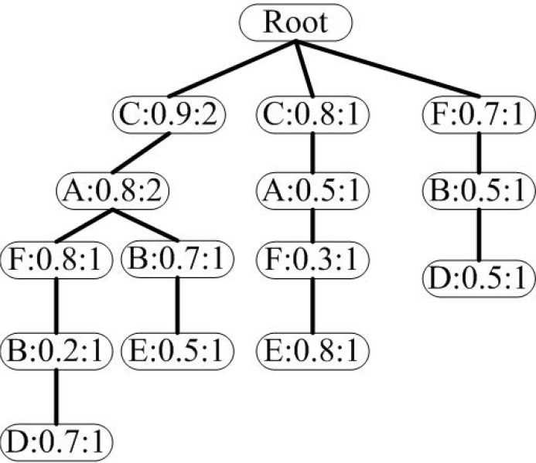
UFP-growth Algorithm
TID | Transaction
T1 | a(0.8) b(0.2) c(0.9) d(0.7) f(0.8)
T2 | a(0.8) b(0.7) c(0.9) e(0.5)
T3 | a(0.5) c(0.8) e(0.8) f(0.3)
T4 | b(0.5) d(0.5) f(0.7)
An Uncertain Transaction Database
UFP-Tree
Notes:
Let’s see the two important definitions in this paper. The first one is…
Based on the first definition, we can define the probabilistic frequent closed itemset.

Slide 20
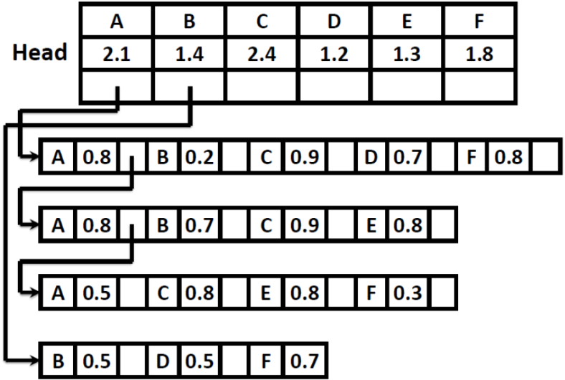
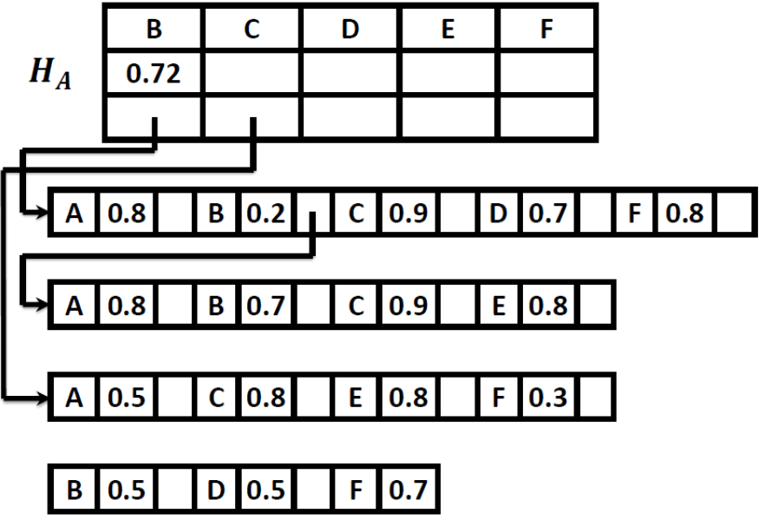
UH-Mine Algorithm
TID | Transaction
T1 | a(0.8) b(0.2) c(0.9) d(0.7) f(0.8)
T2 | a(0.8) b(0.7) c(0.9) e(0.5)
T3 | a(0.5) c(0.8) e(0.8) f(0.3)
T4 | b(0.5) d(0.5) f(0.7)
UDB: An Uncertain Transaction Database
UH-Struct Generated from UDB
UH-Struct of Head Table of A
Notes:
Let’s see the two important definitions in this paper. The first one is…
Based on the first definition, we can define the probabilistic frequent closed itemset.

Slide 21
Experimental Evaluation
Characteristics of Datasets
Dataset | Number of Transactions | Number of Items | Average Length | Density
Connect | 67557 | 129 | 43 | 0.33
Accident | 30000 | 468 | 33.8 | 0.072
Kosarak | 990002 | 41270 | 8.1 | 0.00019
Gazelle | 59601 | 498 | 2.5 | 0.005
T20I10D30KP40 | 320000 | 994 | 25 | 0.025
Default Parameters of Datasets
Dataset | Mean | Var. | min_sup | pft
Connect | 0.95 | 0.05 | 0.5 | 0.9
Accident | 0.5 | 0.5 | 0.5 | 0.9
Kosarak | 0.5 | 0.5 | 0.0005 | 0.9
Gazelle | 0.95 | 0.05 | 0.025 | 0.9
T20I10D30KP40 | 0.9 | 0.1 | 0.1 | 0.9
Notes:
We have conducted a series of experiments on all variants of algorithms and datasets.
The MPFCI is the algorithm with all bounding techniques. We compare it with other four variants with different pruning power, specifically, MPFCI-NoCH is the algorithm without Chernoff bounding, MPFCI-NoBound is without probabilistic bound of the closed probability pruning, MPFFCI-NoSuper is without superset pruning, MPFCI-NoSub is without subset pruning. Besides, we also implemented a breadth-first search-based algorithm, MPFCI-BFS, which only utilizes the Chernoff-Hoeffding bound-based pruning and the frequent closed probability bound-based pruning.
We test all of these algorithms on two datasets. Mushroom is a real certain dataset containing characteristics of various species of mushrooms. We assign a probability generated from Gaussian distribution to each transaction. The second data set is generated by IBM dataset generator, which also follows normal distribution.

Slide 22
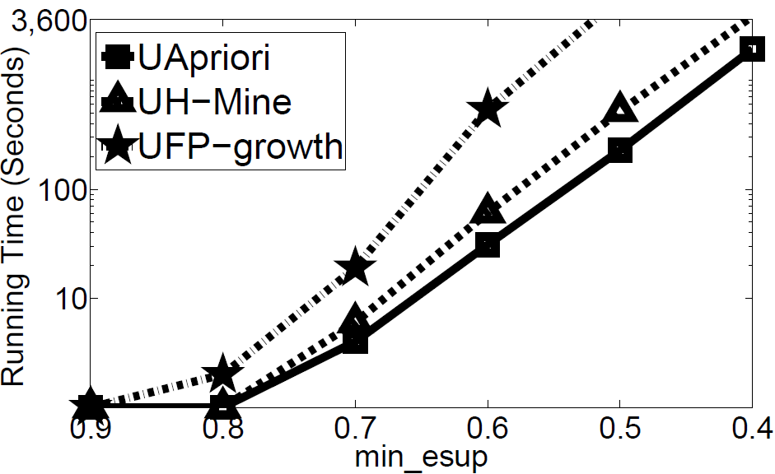
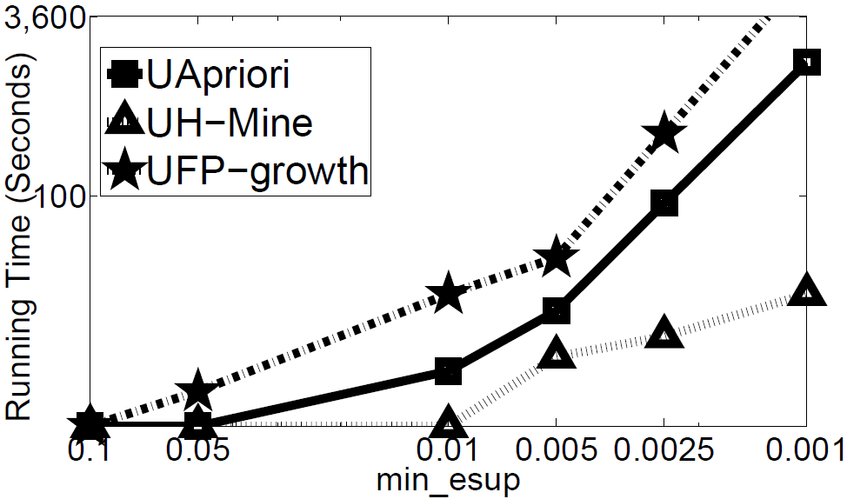
Running Time
(a) Connet (Dense) (b) Kosarak (Sparse)
Running Time w.r.t min_esup
Notes:
Let’s check the trend of running time while varying minimum support value on two datasets.
As we vary the value minimum support from 0.6 to 0.2, the running time increase for all of the algorithms. But we find that MPFCI is the one the slowest increasing speed due to the pruning power it has.
On the contrary, the running time on MPFCI-NoBound increases sharply, because without pruning, every possible itemsets has to be checked in sampling, which is highly time-costly.

Slide 23
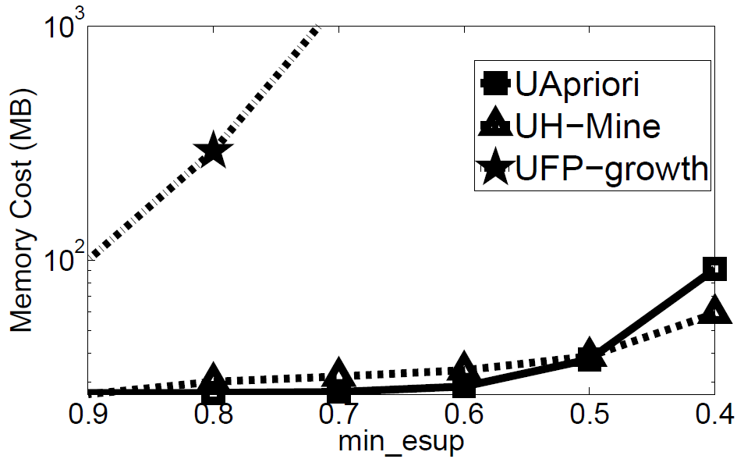
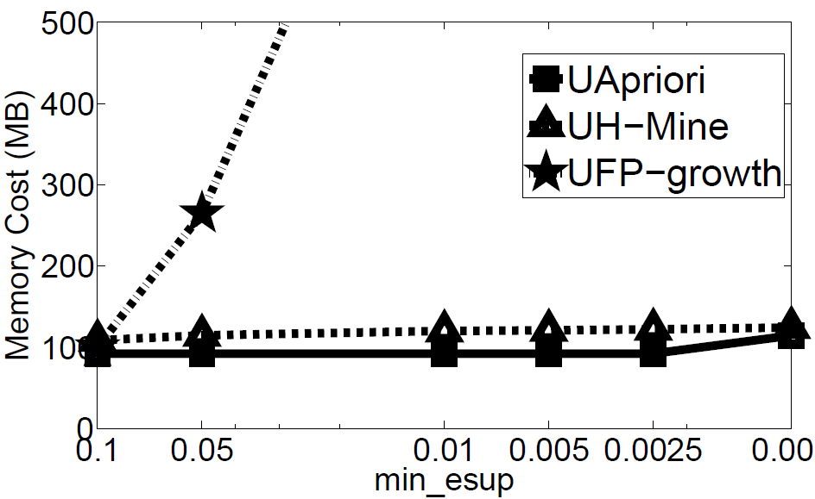
Memory Cost
(a) Connet (Dense) (b) Kosarak (Sparse)
Running Time w.r.t min_esup
Notes:
Let’s check the trend of running time while varying minimum support value on two datasets.
As we vary the value minimum support from 0.6 to 0.2, the running time increase for all of the algorithms. But we find that MPFCI is the one the slowest increasing speed due to the pruning power it has.
On the contrary, the running time on MPFCI-NoBound increases sharply, because without pruning, every possible itemsets has to be checked in sampling, which is highly time-costly.

Slide 24
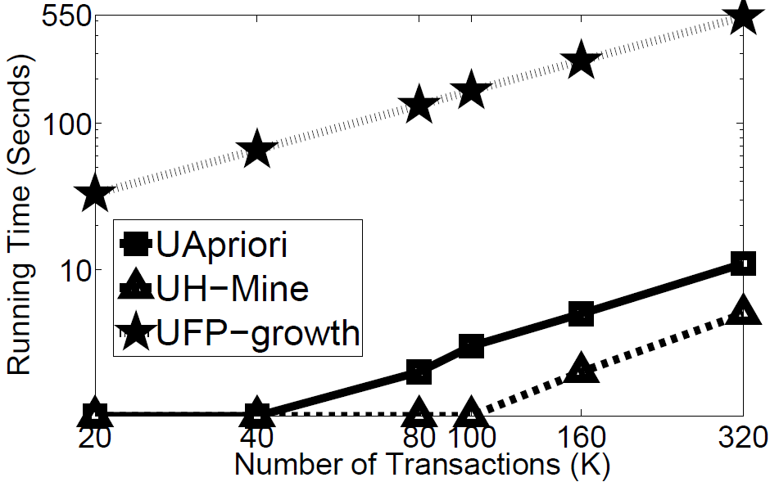
Scalability
Scalability w.r.t Running Time
Notes:
Let’s check the trend of running time while varying minimum support value on two datasets.
As we vary the value minimum support from 0.6 to 0.2, the running time increase for all of the algorithms. But we find that MPFCI is the one the slowest increasing speed due to the pruning power it has.
On the contrary, the running time on MPFCI-NoBound increases sharply, because without pruning, every possible itemsets has to be checked in sampling, which is highly time-costly.

Slide 25
Review: UApiori Vs. UFP-growth Vs. UH-Mine
Dense Dataset: UApriori algorithm usually performs very good
Sparse Dataset: UH-Mine algorithm usually performs very good.
In most cases, UF-growth algorithm cannot outperform other algorithms
Notes:
Recently, uncertain data is prevalent in many real application, such as
In recent years, applications like sensor network, object identification are utilized to provide real-time monitoring of all kinds of environments. The sensory data provides tremendous information, but they also incur great uncertainty.
For example, in an intelligent traffic system, many sensors are deployed to collect real-time traffic data. (show animation) Each time a vehicle passes the monitor, a set of sensory data are collected like weather, time, speed of driving, etc.
However, due to the limitation of sensors, like the measuring ability, battery condition and transmission error, etc., the collected data are not always precise. On the contrary, in most cases, the sensory data are associated with a probability, which indicates how likely such a tuple is correct.

Slide 26
Outline
Motivations
  Examples of Mining Uncertain Frequent Itemsets (FIs)
  Deterministic FI Vs. Uncertain FI
  Evaluation Goals
Problem Definitions
Algorithm Evaluations
  Expected Support-based Frequent Algorithms
  Exact Probabilistic Frequent Algorithms
  Approximate Probabilistic Frequent Algorithms
Conclusions
Notes:
This is the outline of our presentation.
First I will introduce an a motivating example and the concept of probabilistic frequent itemsets.
Then I will briefly introduce the design and performance of the MPFCI algorithm for such problem.

Slide 27
Exact Probabilistic Frequent Algorithms
DP Algorithm (Q. Zhang & K. Yi, in SIGMOD’08; T. Bernecker et al., in KDD’09)
  Use the recursive relationship (K. Yi et al., in ICDE’08; M. Hua et al., in SIGMOD’08)
  Computational Complexity: O(N²)
DC Algorithm (L. Sun et al., in KDD’10)
  Employ the divide-and-conquer framework and the Fast Fourier Transform to compute the frequent probability
  Computational Complexity: O(Nlog²N)
Chernoff Bound-based Pruning
  Computational Complexity: O(N)
Notes:
Let’s see the two important definitions in this paper. The first one is…
Based on the first definition, we can define the probabilistic frequent closed itemset.

Slide 28
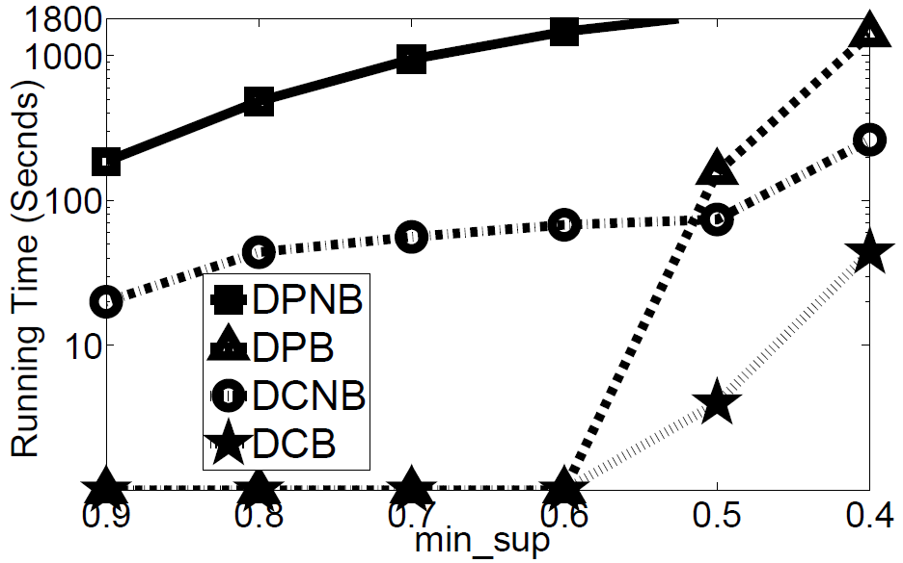
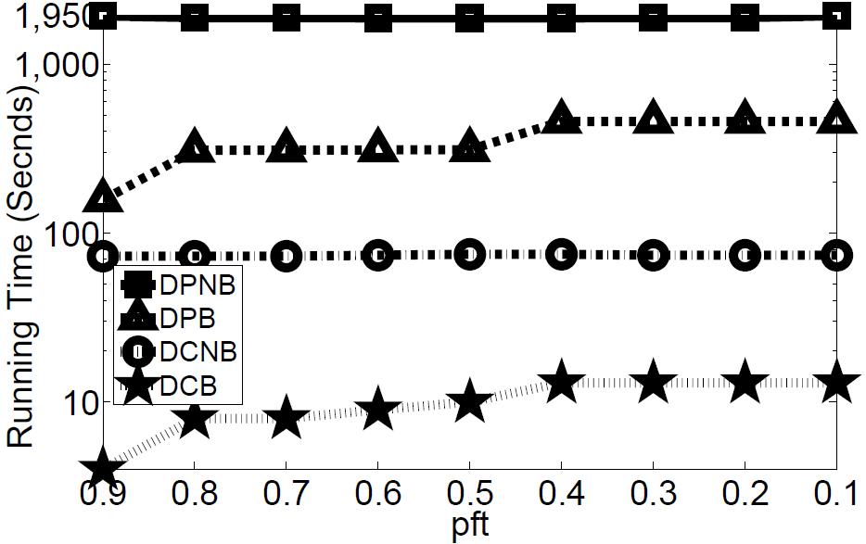
Running Time
(a) Accident (Time w.r.t min_sup) (b) Kosarak (Time w.r.t pft)
Notes:
Let’s check the trend of running time while varying minimum support value on two datasets.
As we vary the value minimum support from 0.6 to 0.2, the running time increase for all of the algorithms. But we find that MPFCI is the one the slowest increasing speed due to the pruning power it has.
On the contrary, the running time on MPFCI-NoBound increases sharply, because without pruning, every possible itemsets has to be checked in sampling, which is highly time-costly.

Slide 29
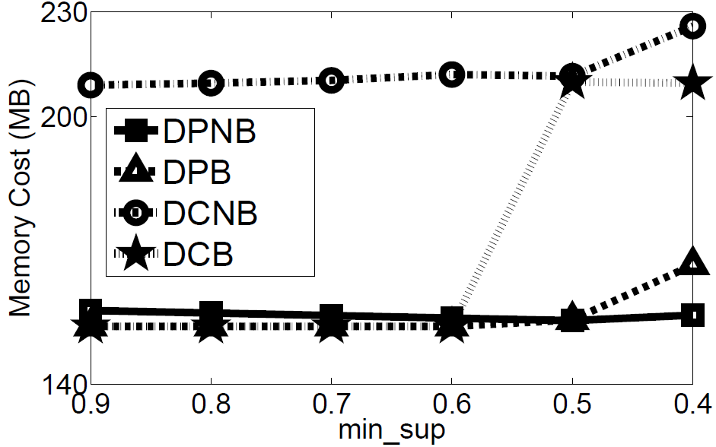
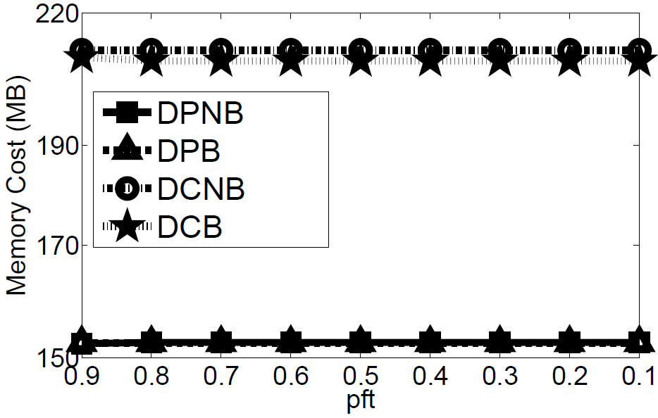
Memory Cost
(a) Accident (Memory w.r.t min_sup) (b) Kosarak (Memory w.r.t pft)
Notes:
Let’s check the trend of running time while varying minimum support value on two datasets.
As we vary the value minimum support from 0.6 to 0.2, the running time increase for all of the algorithms. But we find that MPFCI is the one the slowest increasing speed due to the pruning power it has.
On the contrary, the running time on MPFCI-NoBound increases sharply, because without pruning, every possible itemsets has to be checked in sampling, which is highly time-costly.

Slide 30
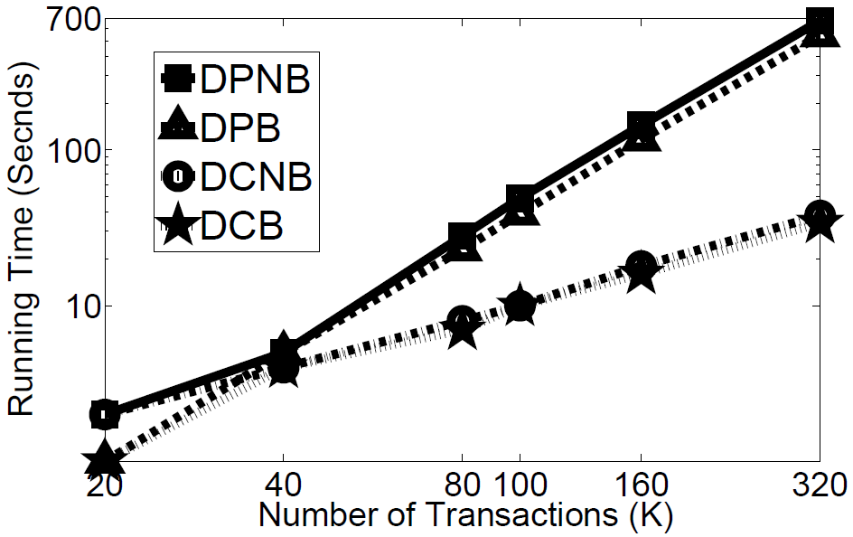
Scalability
Scalability w.r.t Running Time
Notes:
Let’s check the trend of running time while varying minimum support value on two datasets.
As we vary the value minimum support from 0.6 to 0.2, the running time increase for all of the algorithms. But we find that MPFCI is the one the slowest increasing speed due to the pruning power it has.
On the contrary, the running time on MPFCI-NoBound increases sharply, because without pruning, every possible itemsets has to be checked in sampling, which is highly time-costly.

Slide 31
Review: DC Vs. DP
DC algorithm is usually faster than DP, especially for large data.
  Time Complexity of DC: O(Nlog²N)
  Time Complexity of DP: O(N²)
DC algorithm spends more memory in trade of efficiency
Chernoff-bound-based pruning usually enhances the efficiency significantly.
  Filter out most infrequent itemsets
  Time Complexity of Chernoff Bound: O(N)
Notes:
Recently, uncertain data is prevalent in many real application, such as
In recent years, applications like sensor network, object identification are utilized to provide real-time monitoring of all kinds of environments. The sensory data provides tremendous information, but they also incur great uncertainty.
For example, in an intelligent traffic system, many sensors are deployed to collect real-time traffic data. (show animation) Each time a vehicle passes the monitor, a set of sensory data are collected like weather, time, speed of driving, etc.
However, due to the limitation of sensors, like the measuring ability, battery condition and transmission error, etc., the collected data are not always precise. On the contrary, in most cases, the sensory data are associated with a probability, which indicates how likely such a tuple is correct.

Slide 32
Outline
Motivations
  Examples of Mining Uncertain Frequent Itemsets (FIs)
  Deterministic FI Vs. Uncertain FI
  Evaluation Goals
Problem Definitions
Algorithm Evaluations
  Expected Support-based Frequent Algorithms
  Exact Probabilistic Frequent Algorithms
  Approximate Probabilistic Frequent Algorithms
Conclusions
Notes:
This is the outline of our presentation.
First I will introduce an a motivating example and the concept of probabilistic frequent itemsets.
Then I will briefly introduce the design and performance of the MPFCI algorithm for such problem.

Slide 33
Approximate Probabilistic Frequent Algorithms
PDUApriori (L. Wang et al., in CIKM’10)
  Poisson Distribution approximate Poisson Binomial Distribution
  Use the algorithm framework of UApriori
NDUApriori (T. Calders et al., in ICDM’10)
  Normal Distribution approximate Poisson Binomial Distribution
  Use the algorithm framework of UApriori
NDUH-Mine (Our Proposed Algorithm)
  Normal Distribution approximate Poisson Binomial Distribution
  Use the algorithm framework of UH-Mine
Notes:
Let’s see the two important definitions in this paper. The first one is…
Based on the first definition, we can define the probabilistic frequent closed itemset.

Slide 34
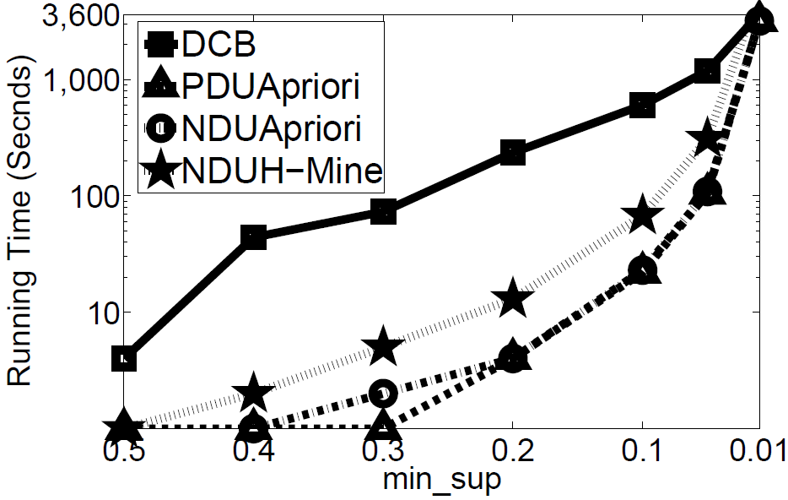
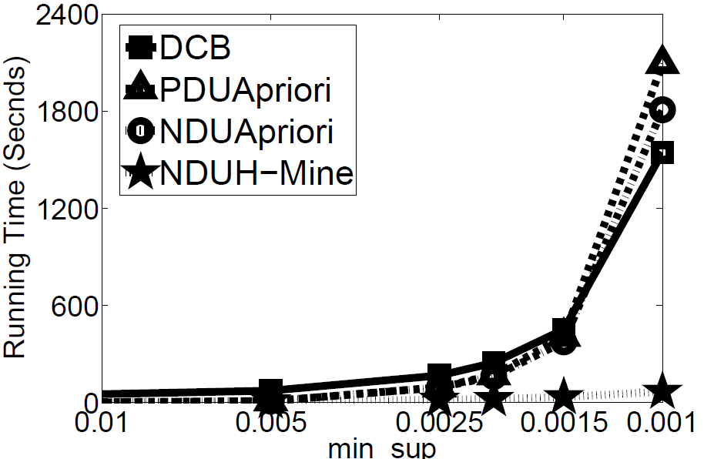
Running Time
(a) Accident (Dense) (b) Kosarak (Sparse)
Running Time w.r.t min_sup
Notes:
Let’s check the trend of running time while varying minimum support value on two datasets.
As we vary the value minimum support from 0.6 to 0.2, the running time increase for all of the algorithms. But we find that MPFCI is the one the slowest increasing speed due to the pruning power it has.
On the contrary, the running time on MPFCI-NoBound increases sharply, because without pruning, every possible itemsets has to be checked in sampling, which is highly time-costly.

Slide 35
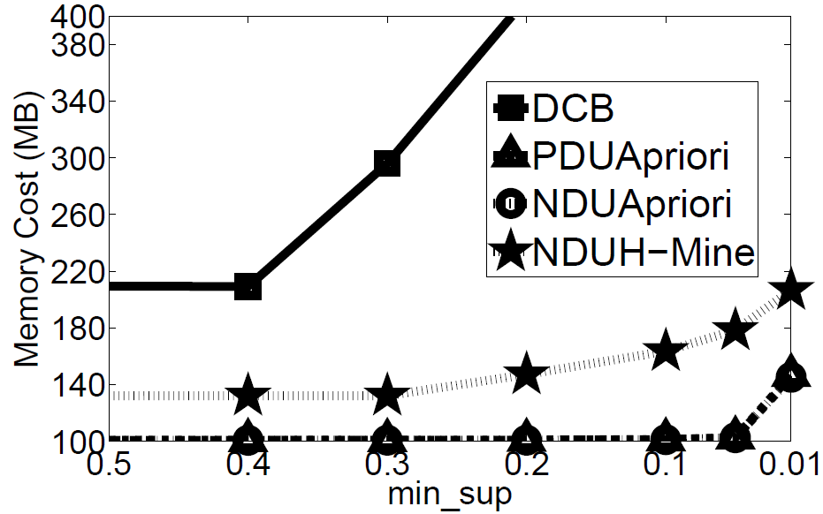
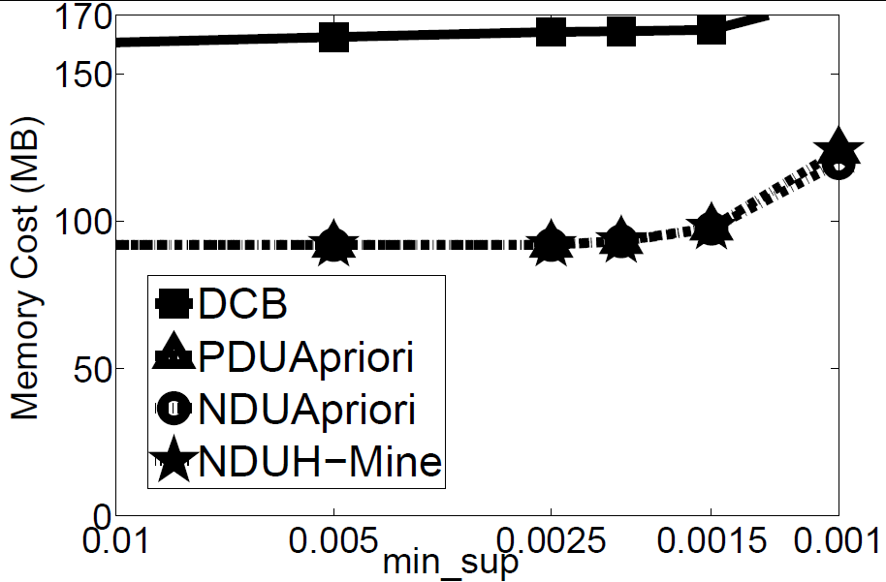
Memory Cost
(a) Accident (Dense) (b) Kosarak (Sparse)
Momory Cost w.r.t min_sup
Notes:
Let’s check the trend of running time while varying minimum support value on two datasets.
As we vary the value minimum support from 0.6 to 0.2, the running time increase for all of the algorithms. But we find that MPFCI is the one the slowest increasing speed due to the pruning power it has.
On the contrary, the running time on MPFCI-NoBound increases sharply, because without pruning, every possible itemsets has to be checked in sampling, which is highly time-costly.

Slide 36
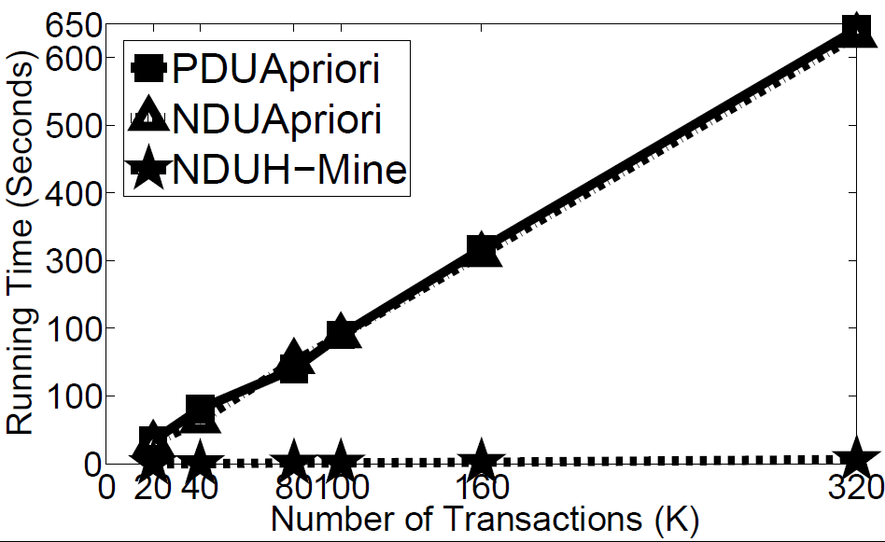
Scalability
Scalability w.r.t Running Time
Notes:
Let’s check the trend of running time while varying minimum support value on two datasets.
As we vary the value minimum support from 0.6 to 0.2, the running time increase for all of the algorithms. But we find that MPFCI is the one the slowest increasing speed due to the pruning power it has.
On the contrary, the running time on MPFCI-NoBound increases sharply, because without pruning, every possible itemsets has to be checked in sampling, which is highly time-costly.

Slide 37
Approximation Quality
Accuracy in Accident Data Set
min_sup | PDUApriori |  | NDUApriori |  | UDUH-Mine
 | Precision | Recall | Precision | Recall | Precision | Recall
0.2 | 0.91 | 1 | 0.95 | 1 | 0.95 | 1
0.3 | 1 | 1 | 1 | 1 | 1 | 1
0.4 | 1 | 1 | 1 | 1 | 1 | 1
0.5 | 1 | 1 | 1 | 1 | 1 | 1
0.6 | 1 | 1 | 1 | 1 | 1 | 1
Accuracy in Kosarak Data Set
min_sup | PDUApriori |  | NDUApriori |  | UDUH-Mine
 | Precision | Recall | Precision | Recall | Precision | Recall
0.0025 | 0.95 | 1 | 0.95 | 1 | 0.95 | 1
0.005 | 0.96 | 1 | 0.96 | 1 | 0.96 | 1
0.01 | 0.98 | 1 | 0.98 | 1 | 0.98 | 1
0.05 | 1 | 1 | 1 | 1 | 1 | 1
0.1 | 1 | 1 | 1 | 1 | 1 | 1
Notes:
We have conducted a series of experiments on all variants of algorithms and datasets.
The MPFCI is the algorithm with all bounding techniques. We compare it with other four variants with different pruning power, specifically, MPFCI-NoCH is the algorithm without Chernoff bounding, MPFCI-NoBound is without probabilistic bound of the closed probability pruning, MPFFCI-NoSuper is without superset pruning, MPFCI-NoSub is without subset pruning. Besides, we also implemented a breadth-first search-based algorithm, MPFCI-BFS, which only utilizes the Chernoff-Hoeffding bound-based pruning and the frequent closed probability bound-based pruning.
We test all of these algorithms on two datasets. Mushroom is a real certain dataset containing characteristics of various species of mushrooms. We assign a probability generated from Gaussian distribution to each transaction. The second data set is generated by IBM dataset generator, which also follows normal distribution.

Slide 38
Review: PDUApriori Vs. NDUApriori Vs. NDUH-Mine
When datasets are large, three algorithms can provide very accurate approximations.
Dense Dataset: PDUApriori and NDUApriori algorithms perform very good
Sparse Dataset: NDUH-Mine algorithm usually performs very good
Normal distribution-based algorithms outperform the Possion distribution-based algorithms
  Normal Distribution: Mean & Variance
  Possion Distribution: Mean
Notes:
Recently, uncertain data is prevalent in many real application, such as
In recent years, applications like sensor network, object identification are utilized to provide real-time monitoring of all kinds of environments. The sensory data provides tremendous information, but they also incur great uncertainty.
For example, in an intelligent traffic system, many sensors are deployed to collect real-time traffic data. (show animation) Each time a vehicle passes the monitor, a set of sensory data are collected like weather, time, speed of driving, etc.
However, due to the limitation of sensors, like the measuring ability, battery condition and transmission error, etc., the collected data are not always precise. On the contrary, in most cases, the sensory data are associated with a probability, which indicates how likely such a tuple is correct.

Slide 39
Outline
Motivations
  Examples of Mining Uncertain Frequent Itemsets (FIs)
  Deterministic FI Vs. Uncertain FI
  Evaluation Goals
Problem Definitions
Algorithm Evaluations
  Expected Support-based Frequent Algorithms
  Exact Probabilistic Frequent Algorithms
  Approximate Probabilistic Frequent Algorithms
Conclusions
Notes:
This is the outline of our presentation.
First I will introduce an a motivating example and the concept of probabilistic frequent itemsets.
Then I will briefly introduce the design and performance of the MPFCI algorithm for such problem.

Slide 40
Conclusions
Expected Support-based Frequent Itemset Mining Algorithms
  Dense Dataset: UApriori algorithm usually performs very good
  Sparse Dataset: UH-Mine algorithm usually performs very good
  In most cases, UF-growth algorithm cannot outperform other algorithms
Exact Probabilistic Frequent Itemset Mining Algorithms
  Efficiency: DC algorithm is usually faster than DP
  Memory Cost: DC algorithm spends more memory in trade of efficiency
  Chernoff-bound-based pruning usually enhances the efficiency significantly
Approximate Probabilistic Frequent Itemset Mining Algorithms
  Approximation Quality: In datasets with large size, the algorithms generate very accurate approximations.
  Dense Dataset: PDUApriori and NDUApriori algorithms perform very good
  Sparse Dataset: NDUH-Mine algorithm usually performs very good
  Normal distribution-based algorithms outperform the Possion-based algorithms
Notes:
Recently, uncertain data is prevalent in many real application, such as
In recent years, applications like sensor network, object identification are utilized to provide real-time monitoring of all kinds of environments. The sensory data provides tremendous information, but they also incur great uncertainty.
For example, in an intelligent traffic system, many sensors are deployed to collect real-time traffic data. (show animation) Each time a vehicle passes the monitor, a set of sensory data are collected like weather, time, speed of driving, etc.
However, due to the limitation of sensors, like the measuring ability, battery condition and transmission error, etc., the collected data are not always precise. On the contrary, in most cases, the sensory data are associated with a probability, which indicates how likely such a tuple is correct.

Slide 41
Thank you
Our executable program, data generator, and all data sets can be found: http://www.cse.ust.hk/~yxtong/vldb.rar

Slide 42
Motivation Example 2
According to medical records of patients, many probabilistic data of patients can be collected.
The record of each patient includes a set of probabilities. Each probability means the chance or the frequency of the corresponding symptom during a period of time.
It is interesting and useful to discover some potential association to support further diagnosis and treatments.
PID | Anorexia | Hyperglycemia | …… | Anxiety Disorder
Patient1 | 0.05 | 0.87 | …… | 0.92
Patient2 | 0.5 | 0.65 | …… | 0.33
Patient3 | 0.92 | 0.05 | …… | 0.85
…… | …… | …… | …… | ……
Table: Medical records of patients during 3 months
Notes:
Recently, uncertain data is prevalent in many real application, such as
In recent years, applications like sensor network, object identification are utilized to provide real-time monitoring of all kinds of environments. The sensory data provides tremendous information, but they also incur great uncertainty.
For example, in an intelligent traffic system, many sensors are deployed to collect real-time traffic data. (show animation) Each time a vehicle passes the monitor, a set of sensory data are collected like weather, time, speed of driving, etc.
However, due to the limitation of sensors, like the measuring ability, battery condition and transmission error, etc., the collected data are not always precise. On the contrary, in most cases, the sensory data are associated with a probability, which indicates how likely such a tuple is correct.

Slide 43
Which Is Better in The Two Definitions
TID | Transaction
T1 | a(0.8) b(0.2) c(0.9) d(0.5) e(0.9)
T2 | a(0.8) b(0.7) c(0.9) d(0.5) f(0.7)
T3 | a(0.5) c(0.9) f(0.1) g(0.4)
T4 | b(0.5) f(0.1)
sup(d) | 0 | 1 | 2
Probability | 0.25 | 0.5 | 0.25
The Probability Distribution of sup(a)
sup(e) | 0 | 1
Probability | 0.1 | 0.9
An Uncertain Transaction Database
The Probability Distribution of sup(e)
The difference between the two definitions
  esup(d)=0.5+0.5=1, esup(e)=0.9, so esup(d) > esup(e).
  Pr(sup(d)>1)=0.75, Pr(sup(e)>1)=0.9, so Pr(sup(d)>1) < Pr(sup(e)>1)
So, which definition is better?
Notes:
Let’s see the two important definitions in this paper. The first one is…
Based on the first definition, we can define the probabilistic frequent closed itemset.

